Slide 1
Encrypted Virtual Private Network in Secure Internet of Things Technology
- Nivethitha subaschandra bose
- Prashant krishnan iyer
- Rajaputhri maharaja

Slide 2
WHAT IS IOT ???
Internet of things..

Slide 3
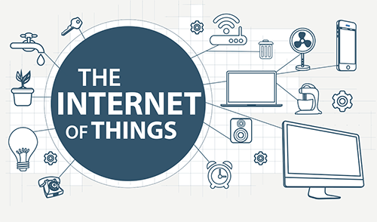
INTERNET OF THINGS !!!
The Internet of Things introduces a vision of a future Internet where users, computing systems, and everyday objects cooperate seamlessly.
IoT for short, is a new interconnection of technology heralded as the next industrial revolution—implying radical change, disruption, and an entirely new paradigm for the planet

Slide 4
Advantages
Safety, Comfort, Efficiency
Measuring and managing hazardous environments without putting people at risk, and optimizing all physical environments for comfort and productivity while controlling energy costs.
Better Decision Making
Analysing larger trends from empirical data, can make smarter decisions.
Revenue Generation
At first, the above benefits from the IoT will impact your bottom line simply by reducing expenses and improving efficiency.
The IoT may be the “X factor” that gives many organizations a strategic advantage over the competitors in the next decade.

Slide 5
Challenges in IOT:
Sensing a complex environment:
Innovative ways to sense and deliver information from the physical
world to the cloud.
Connectivity:
Variety of wired and wireless connectivity standards are required to enable different application needs.
Power:
Many IOT applications need to run for years over batteries and reduce the overall energy consumption.
Security is vital:
Protecting users privacy and manufacturers IP detecting and blocking malicious activity.

Slide 6
M2M Communication
It forms the base of IoT Architecture.
The end-devices usually form Machine to Machine (M2M) networks using various radio technologies, such as ZigBee, Wi-Fi and many more.
Advantages :
Low Bandwidth
Low Upload biased traffic

Slide 7
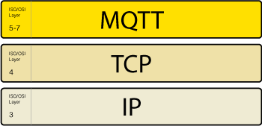
MQTT
What is MQTT ?
Message Queue Telemetry Transport (MQTT) protocol is an extremely
lightweight communication protocol that forms the base of M2M
communicational architecture.
It is a publish/subscribe messaging protocol unlike the request/response
since messages need not be responded, thereby reducing the network
bandwidth. MQTT ensures high reliability by providing Quality of Service at
all levels.
Decoupling of publisher and subscriber.
Advantages :
Low Latency
High Reliability
Reduced Network Bandwidth

Slide 8
Virtual Private Networks (VPN):
A Virtual Private Networks (VPN) allows you to connect to the internet via a server run by a VPN provider.
In a VPN, the computers at each end of the tunnel encrypt the data entering the tunnel and decrypt it at the other end.
However, a VPN needs more than just a pair of keys to apply encryption.
The basic idea is to configure a “TLS/SSL” TCP port for the MQTT clients to use when connecting to the VPN.

Slide 9
Research Problem:
Security In IoT Is Vital
Some of the common techniques for security include
Encryption of data
Combination of different protocols.
Attacks possible are Man in the middle attack or Evesdropping.

Slide 10
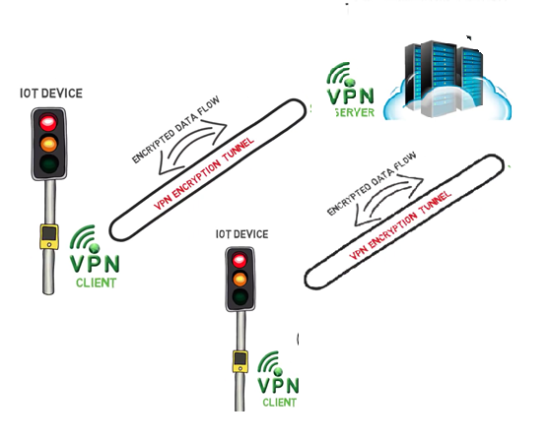
Proposed Solution:

Slide 11
Proposed Solution:
Setting up an Encrypted VPN channelled infrastructure for IoT.
Our research aims in providing a detailed summary of the difference in Latency for the requests to get processed when the VPN server is set on the Raspberry-Pi versus on the cloud.
The proposed system also aims in building up three models
A local MQTT server setup on a Raspberry-Pi.
A cloud MQTT server.
An Hybrid model in which higher order(in terms of processing speed and complexity) requests to be processed on the Raspberry-Pi and the requests with less overhead on the cloud.

Slide 12
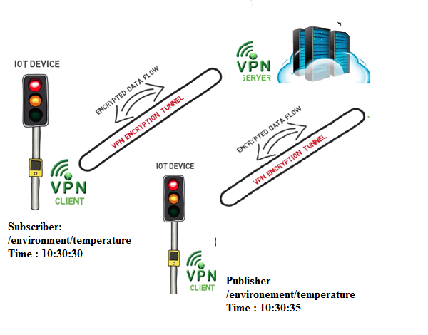
Latency Calculation:
Our Proposed System calculates end-to-end Latency (i.e.) the delay before a transfer of data begins following an instruction for its transfer.
{
message_id = m
topic = temperature
temp
{
Celsius = c
Fahrenheit = f
publisher_time = t
}
}

Slide 13
Latency Calculation in local server:

Slide 14
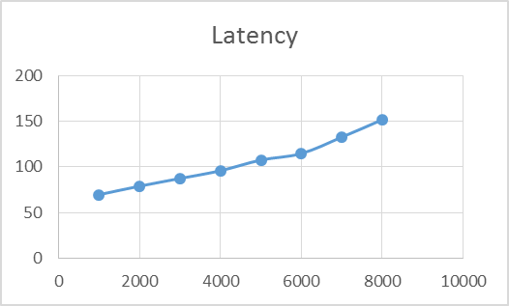
Latency Calculation in Local Server

Slide 15
Latency Calculation in cloud server:

Slide 16
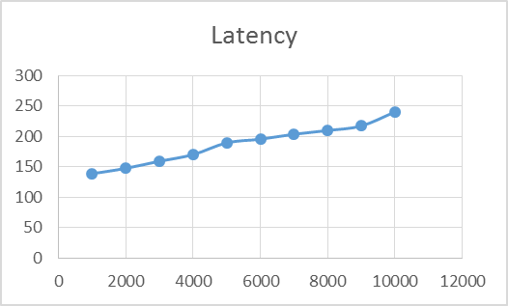
Latency Calculation In Cloud Server

Slide 17
Bandwidth Calculation:
Bandwidth is defined as the ability to transfer data (like Json, VOIP call) from one point to another in a fixed amount of time.
The Bandwidth needed for data transmission in M2M communication depends on a few factors namely
Packet overhead.
Network Protocol used. (In this case MQTT,TCP-IP)
Overhead due to compression technologies if any used.
For Ex: If latency = 10ms (For one data packet request),100 such data packet requests are required to be transmitted every second. Each packet carries network protocol overheads.

Slide 18
Bandwidth Calculation:
For Bandwidth calculation in M2M communication we also need to keep into account , the overhead of
MQTT of the data to be sent.
TCP to the MQTT packet.
TCP to the data sent.
And not taking into account , the connectivity, keep alive and many more aspects.
TCP/IP header size = 40 bytes.
For Instance 1) Data size = 1Byte
1Bytes * 40Bytes = 40Bytes = 4100% TCP/IP overhead
i.e 41Bytes of data is actually transmitted ….

Slide 19
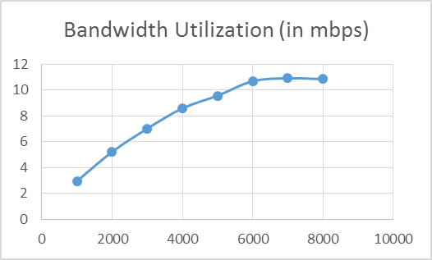
Bandwidth Utilization in Local Server

Slide 20
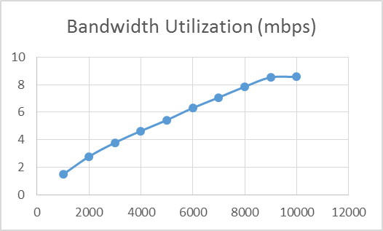
Bandwidth Calculation in Cloud Server

Slide 21
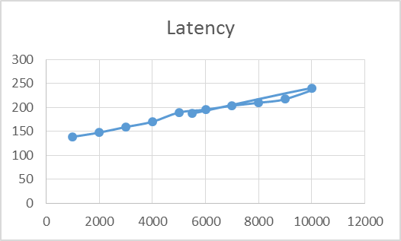
Latency Calculation in Hybrid Mode

Slide 22
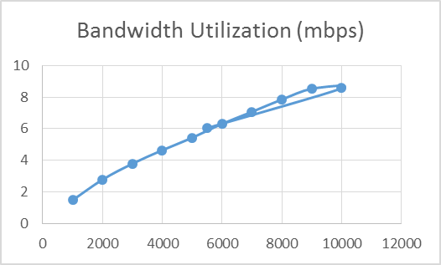
Bandwidth Utilization In Hybrid Mode

Slide 23
CONCLUSION
The model that our team has proposed is one of the best alternatives to
Existing security challenges
Secure IoT M2M communication
Bring in standardization of security principles to be implemented
Authentication of the clients participating in the communication
Cost effective security
Is Standalone executable on Windows, Mac OS X, Linux, Android and IOS
Support for simultaneous users
Provides Network access control
Authenticating a client-side digital certificate

Slide 24
FUTURE WORK
It includes :
Designing a cross-platform, secure and an highly configurable VPN solution that considers certain potential factors for increasing the performance (like reducing network overhead and having efficient bandwidth), such as
payload length, encryption key size, encryption digest, TLS digest, etc.

Slide 25
FUTURE WORK
Also in addition to the tests performed, the results should be verified using some analytical modelling of data.
This will help us understand how each of these factors affects the performance and why.

Slide 26
Thank You !!!

